Slide 1
Predictive Model for Stroke Risk Assessment using Machine Learning and Data Preprocessing
Swaraj Khan P

Slide 2

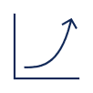



Project Workflow
Step 1
Step 2
Step 3
Step 4
Step 5
Data Preprocessing and Exploration
Data Visualization and Correlation Analysis
Feature Engineering and Encoding
Data Balancing and Model Building
Model Evaluation and Conclusion

Slide 3
INTRODUCTION
we explore the process of predicting brain strokes using machine learning. We start by analyzing a healthcare dataset, handling missing values, and removing outliers. Through visualizations, we gain insights into factors affecting strokes. The dataset is preprocessed, encoded, and balanced using techniques like SMOTE. Multiple models, including Logistic Regression, Decision Trees, Random Forest, are trained and evaluated for their predictive accuracy. Finally, the best-performing model is saved for potential future use.

Slide 4
Data Collection and Exploration
loading and analyzing the healthcare dataset to understand its structure, identifying missing values, and visualizing key features to gain insights into potential factors influencing stroke predictions

Slide 5
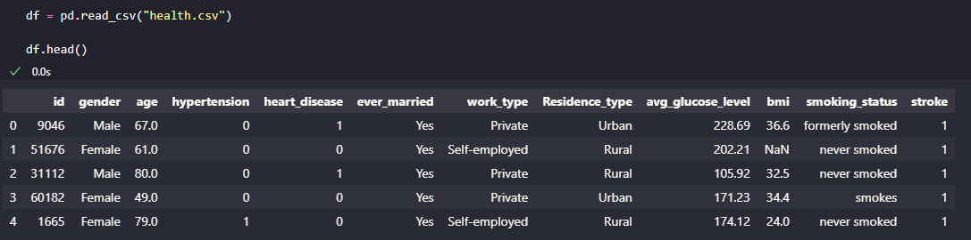
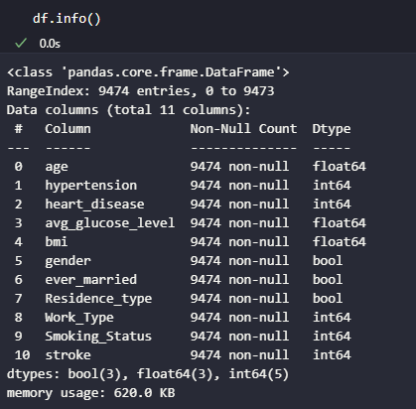
The code reads the CSV file named "health.csv" and creates a Data Frame named "df" to store the data. The .head() function then displays the first few rows of the Data Frame for initial data exploration.
The df.info() function provides a concise summary of the Data Frame "df," including the column names, the count of non-null values in each column, and the data types of the columns.
dataset

Slide 6
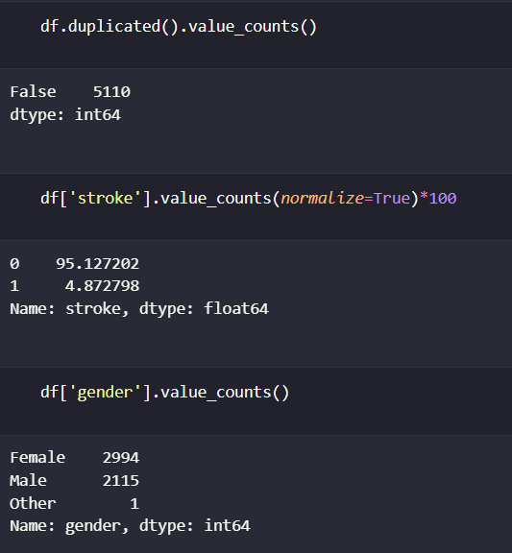
The goal is to predict if a person will face a stroke or not, but the data provided is a biased dataset where all the data is leaning towards “no stroke”
For this we will need to balance the dataset.

Slide 7
Data Visualization
Let’s represent the data in a pictorial format for better understanding

Slide 8
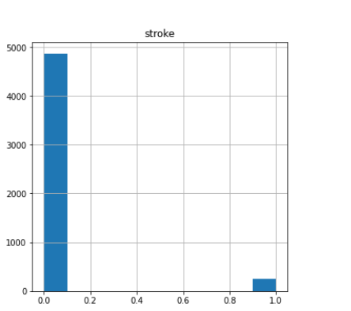
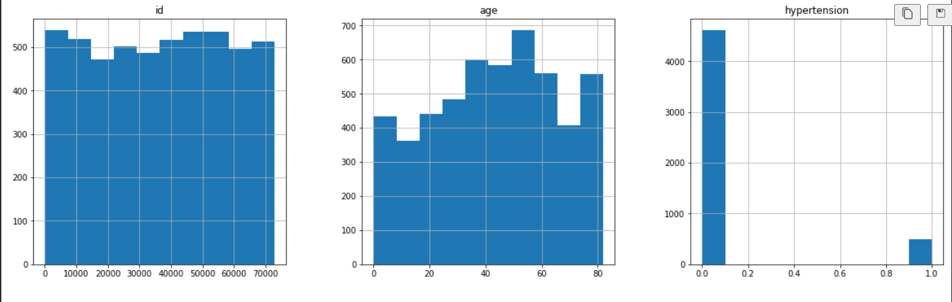
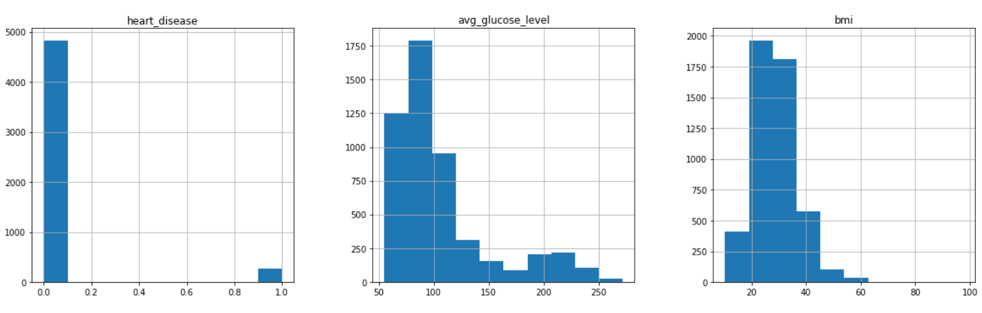
FREQUENCY VS PARAMETERS

Slide 9
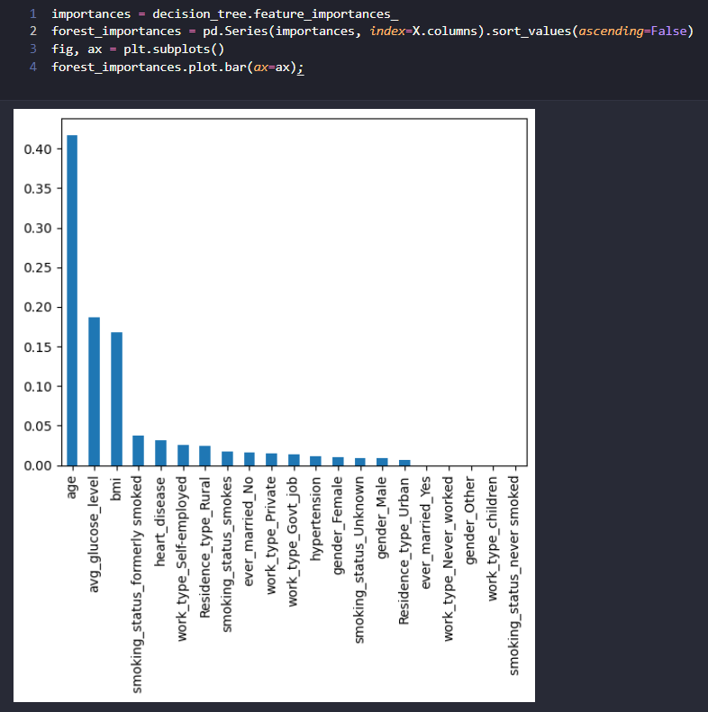
TOP 3 INFLUENCING PARAMETERS
Age
Glucose level
BMI
Age is a significant factor in stroke prediction, as older individuals tend to have a higher risk.
The glucose level is important because elevated levels can indicate conditions like diabetes, which is a known risk factor for stroke.
BMI is a measure of body composition and obesity. Higher BMI values may suggest an increased likelihood of cardiovascular issues.

Slide 10
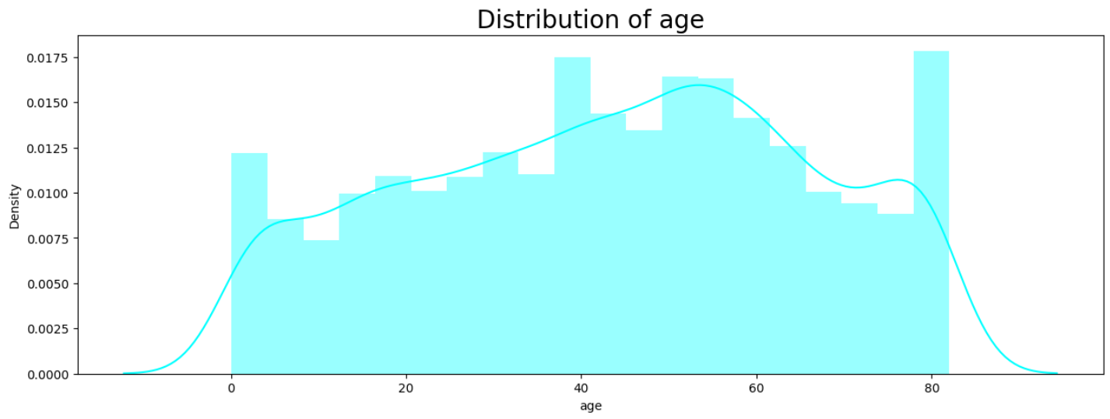
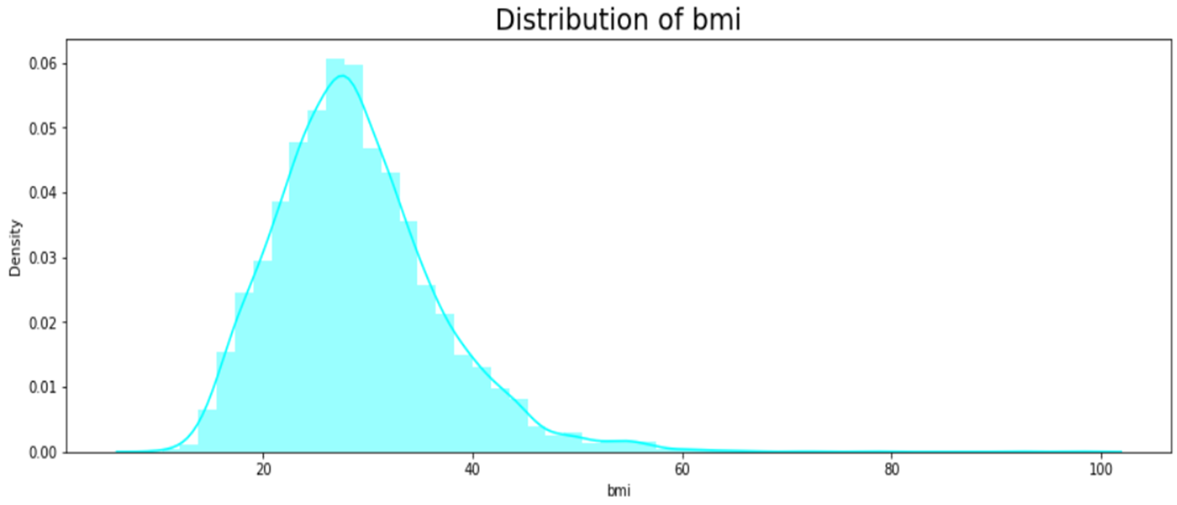
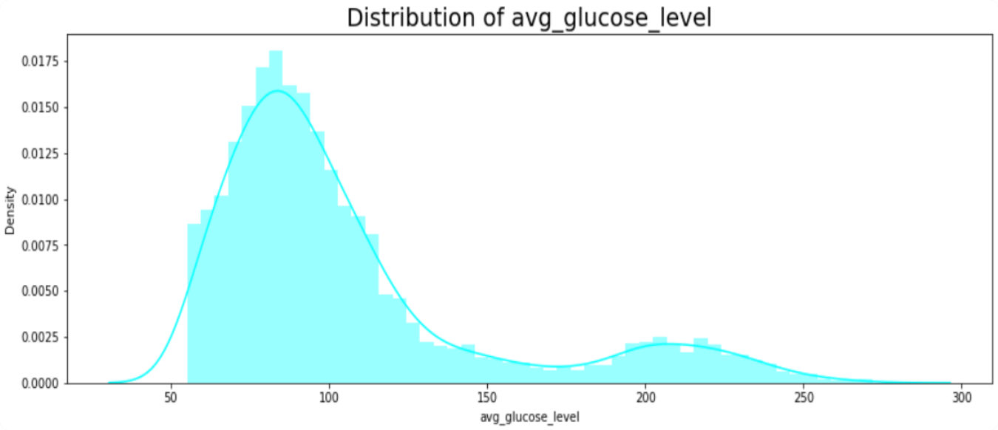
TOP 3 INFLUENCING PARAMETERS
The frequency of people ranging from age 40-60 is the highest
The frequency of people falling under BMI range of 25-35 is the highest
The frequency of people having glucose level of range 70-90 is the highest

Slide 11
Balancing the Target Variable
Aim is to determine stroke predictability, Hence Stroke will be our target variable

Slide 12
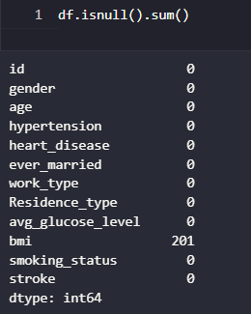
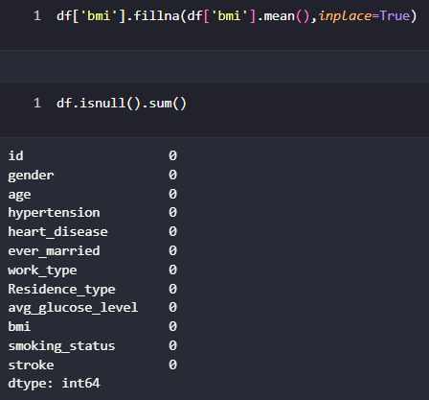
Handling Missing Values
We have chosen to fill the missing values by the mean values

Slide 13
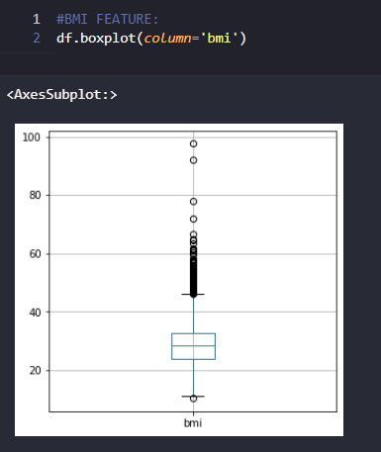
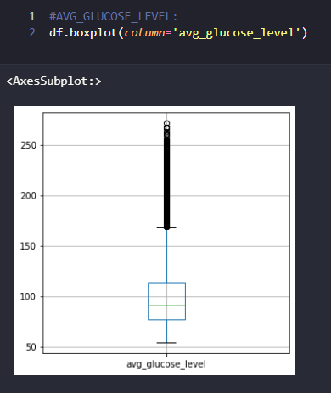
Outliers
Simply speaking, Outlier is an observation that appears far away and diverges from an overall pattern in a sample.

Slide 14
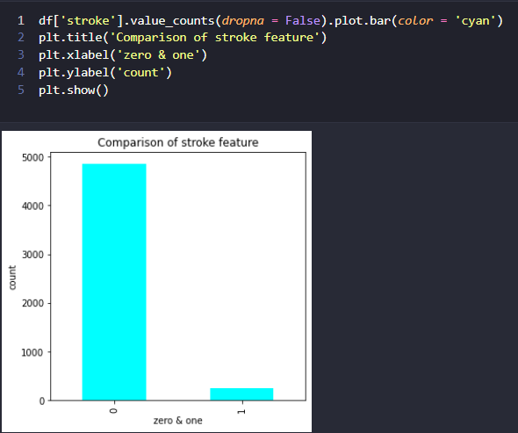
Handling Missing Values
Here we notice that the data is completely imbalanced, and we need to work on this by pre-processing techniques. Few of them are- removing the null values, replacing the null values with mean/avg value, KNN imputer or
Deletion
There are several techniques that can be used to handle highly imbalanced class. we are going to use one of oversampling technique called Synthetic Minority Oversampling Technique (SMOTE), by synthesizing new samples from the minority class to have the same number of samples as the majority class (illustrated in figure below). Oversampling technique is chosen because we do not want to loose significant amount of information (97.88%) as if we use under sampling technique.
no stroke: 3550 stroke: 249

Slide 15
Feature engineering
Let’s see the relationship between each parameter

Slide 16
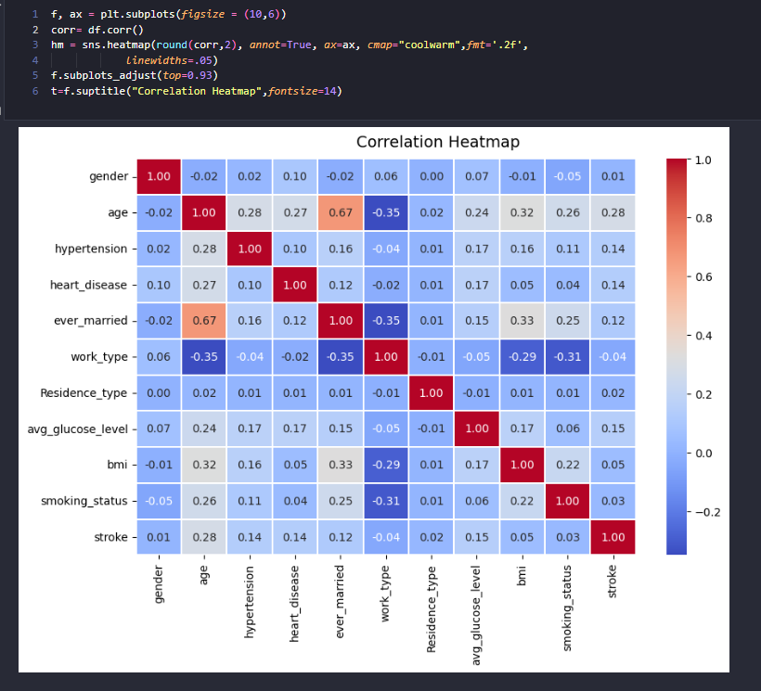
Correlation Matrix heatmap
Inter-feature correlation analysis provides valuable insights.
High correlation between a feature and the target suggests its significance.
Strong correlations between features might justify feature reduction for simplicity.
Enhances the model's learning potential by optimizing feature selection.

Slide 17
MODEL BUILDING +EVALUATION
Let’s split the data, train and evaluate our model

Slide 18
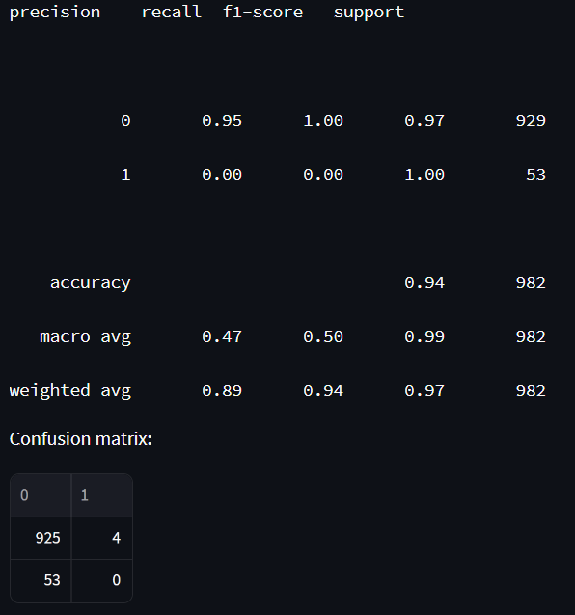
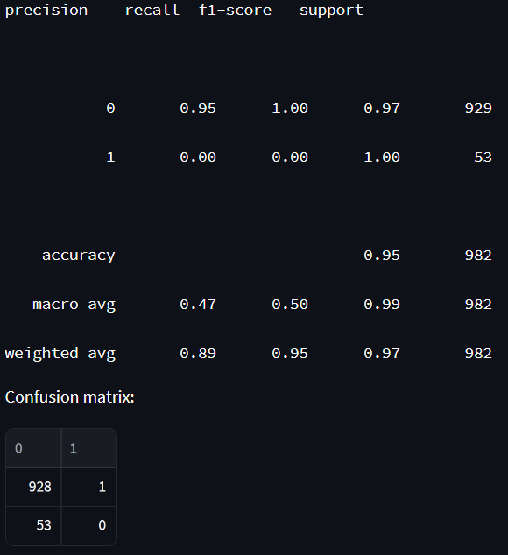
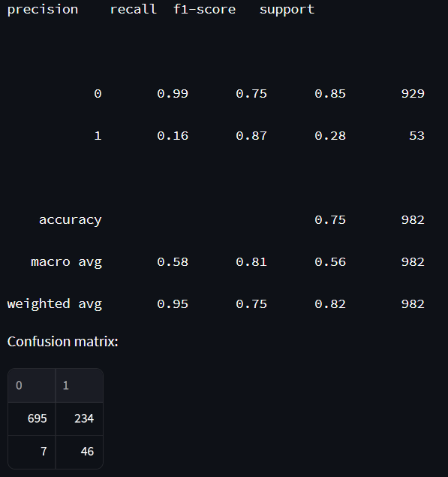
MODEL PERFORMANCE
Gradient boosting
Random Forest
Logistic Regression
Click here to try

Slide 19
MODEL PERFORMANCE
Gradient boosting
Random Forest
Logistic Regression
Click here to try

Slide 20
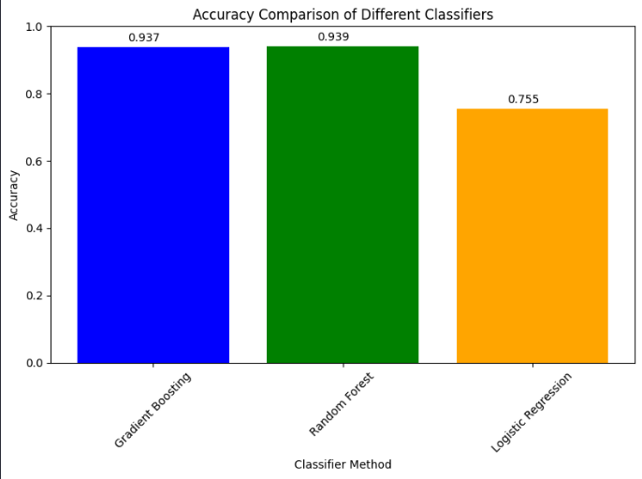
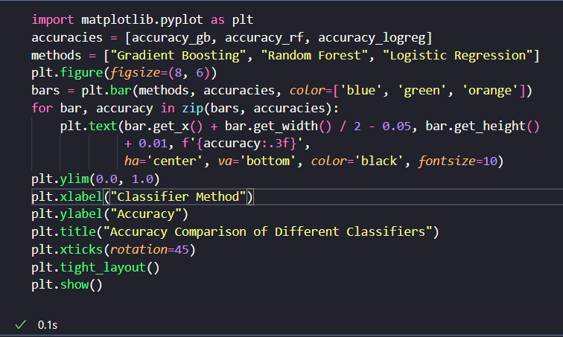
MODEL PERFORMANCE
Click here to try

Slide 21
SUMMARY
stroke prediction through simple data analysis. We examine age, glucose levels, and BMI to anticipate strokes accurately. Witness data cleaning, visualization, and model creation, demystifying how healthcare insights are uncovered from everyday data.

Slide 22
Links
Kaggle dataset – here
Streamlit app – here
GitHub repo - here

Slide 23
THANK YOU
Swaraj Khan P
Swaraj.khan@disys.com

